Slide 1

Crop production analysis
By
Sanjit cyrus r

Slide 2

AGENDA
Introduction and flow of project
Information about the dataset
Exploratory Data Analysis
Feature Engineering
Machine learning model
Conclusion

Slide 3

Introduction and flow of project

Slide 4
Introduction
The need to increase agricultural output is more important than ever because of the world's population growth and the threat posed by climate change. The foundation of this effort is crop production, which is essential to global economic stability and food security. Understanding how crucial it is to maximize crop yields, our study sets out to examine, evaluate, and ultimately enhance the complexities of agricultural production.
This project focuses on the variables that affect crop production using correlation coefficient and ANOVA analysis, Another focus is also on building a machine learning model that accurately predicts the crop production.

Slide 5
Flow of project
Data Preprocessing
Exploratory Data Analysis
Feature Engineering
Machine Learning model

Slide 6

Important note
For the purpose of this project categorical columns mean the columns in the dataset namely State_name, District_name, Crop_Year, Season, Crop.
Categories mean the individual categories within the categorical columns.

Slide 7
Information about the dataset

Slide 8
Information about dataset
The Dataset for the crop prediction has 2,46,091 rows and 7 columns. The columns are named State_name, District_name, Crop_Year, Season, Crop, Area, Production.
Here State_name, District_name, Crop_Year, Season, Crop are categorical variables while Area and Production are numeric variables
While checking for missing values we find that the column production has 3730 missing values. Since the number of missing values is low we have dropped the rows and proceeded with the further analysis

Slide 9
Exploratory data analysis

Slide 10

Exploratory data analysis (EDA)
EDA provides us an opportunity to explore the data and find hidden patterns and meanings in the data

Slide 11
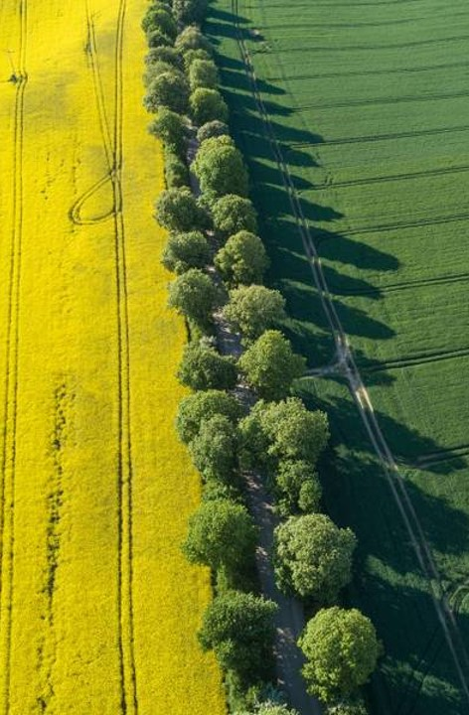
Exploratory data analysis
The power BI dashboard for exploratory data analysis has 4 pages and each page is titled as followed.
Crop Production
Crop Production when top two crops are removed
Crop Production area
Crop production area when top crop is removed
The pages Crop production and Crop Production when top two crops are removed has the following visuals
Crop production by type of crop
Crop production by year
Crop production by State
Crop production by District
Crop production by Season
All the visuals except the year visual are set such that only the top 5 values are displayed.
The dashboard and their insights are explained in the upcoming slides

Slide 12



Crop production EDA
View in Power BI
Last data refresh:
4/10/2024 9:31:23 AM UTC
Downloaded at:
4/14/2024 3:17:55 PM UTC

Slide 13
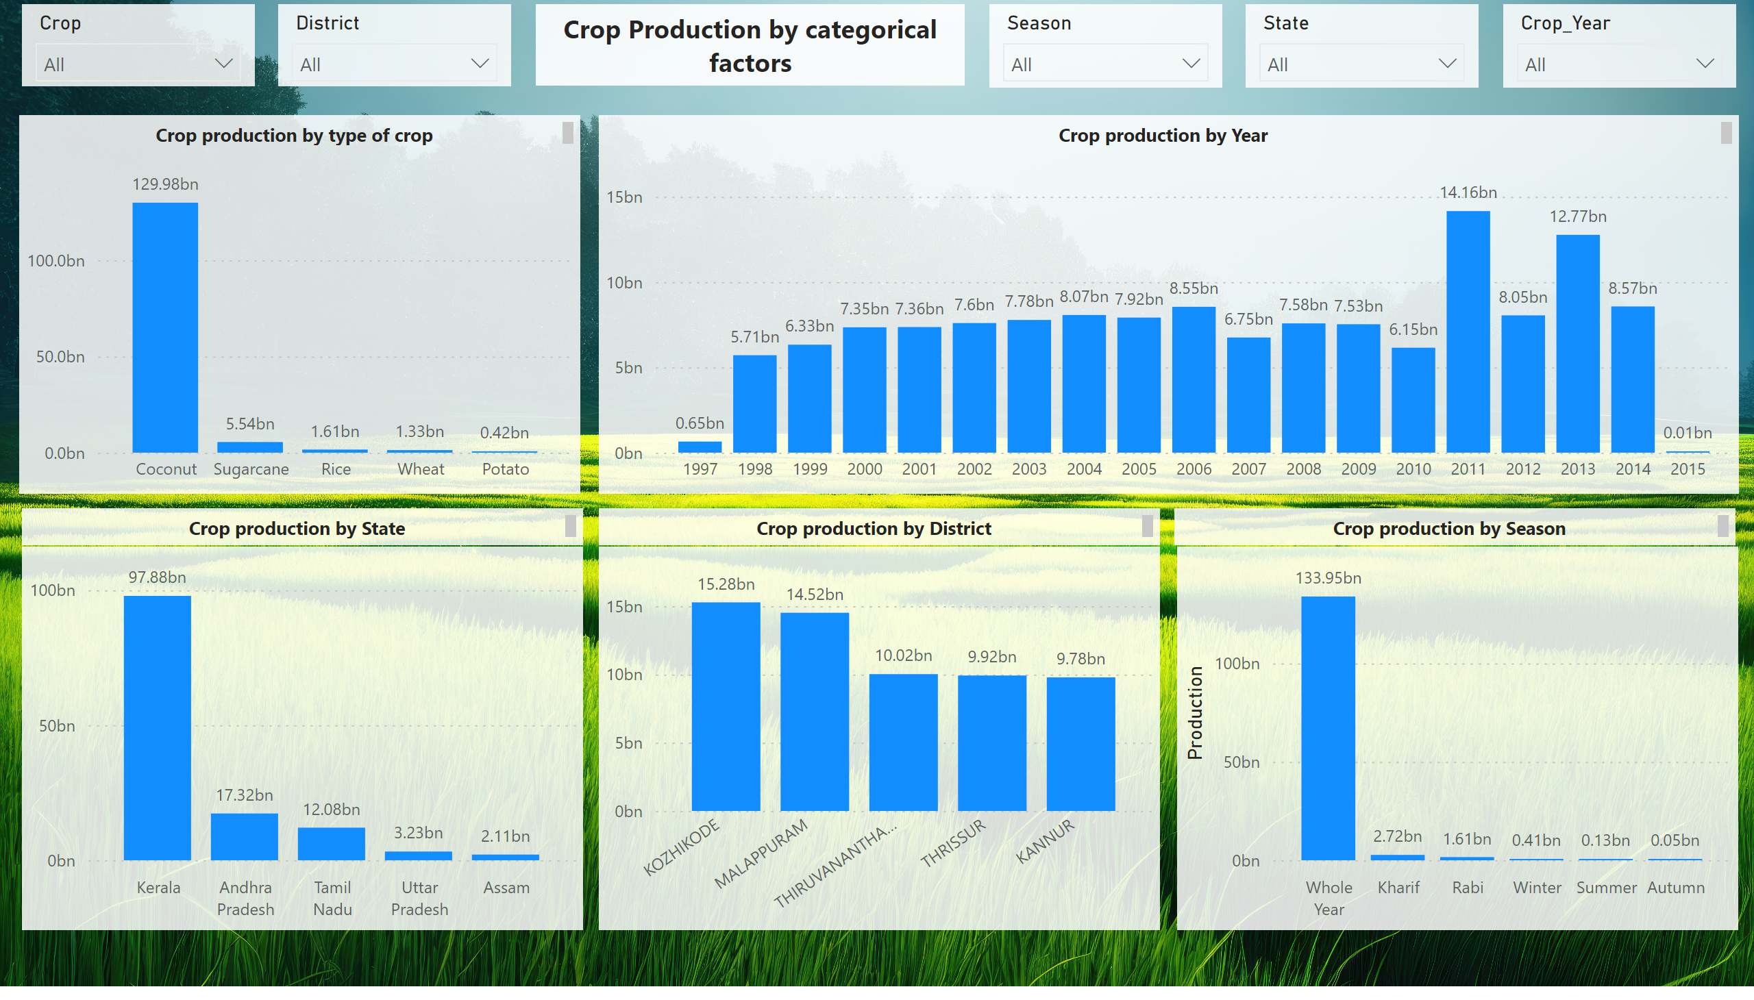
Production
Notes:
clusteredColumnChart
No alt text provided
slicer
No alt text provided
slicer
No alt text provided
slicer
No alt text provided
slicer
No alt text provided
slicer
No alt text provided
clusteredColumnChart
No alt text provided
clusteredColumnChart
No alt text provided
clusteredColumnChart
No alt text provided
clusteredColumnChart
No alt text provided
textbox
No alt text provided
textbox
No alt text provided
textbox
No alt text provided
textbox
No alt text provided
textbox
No alt text provided
textbox
No alt text provided

Slide 14
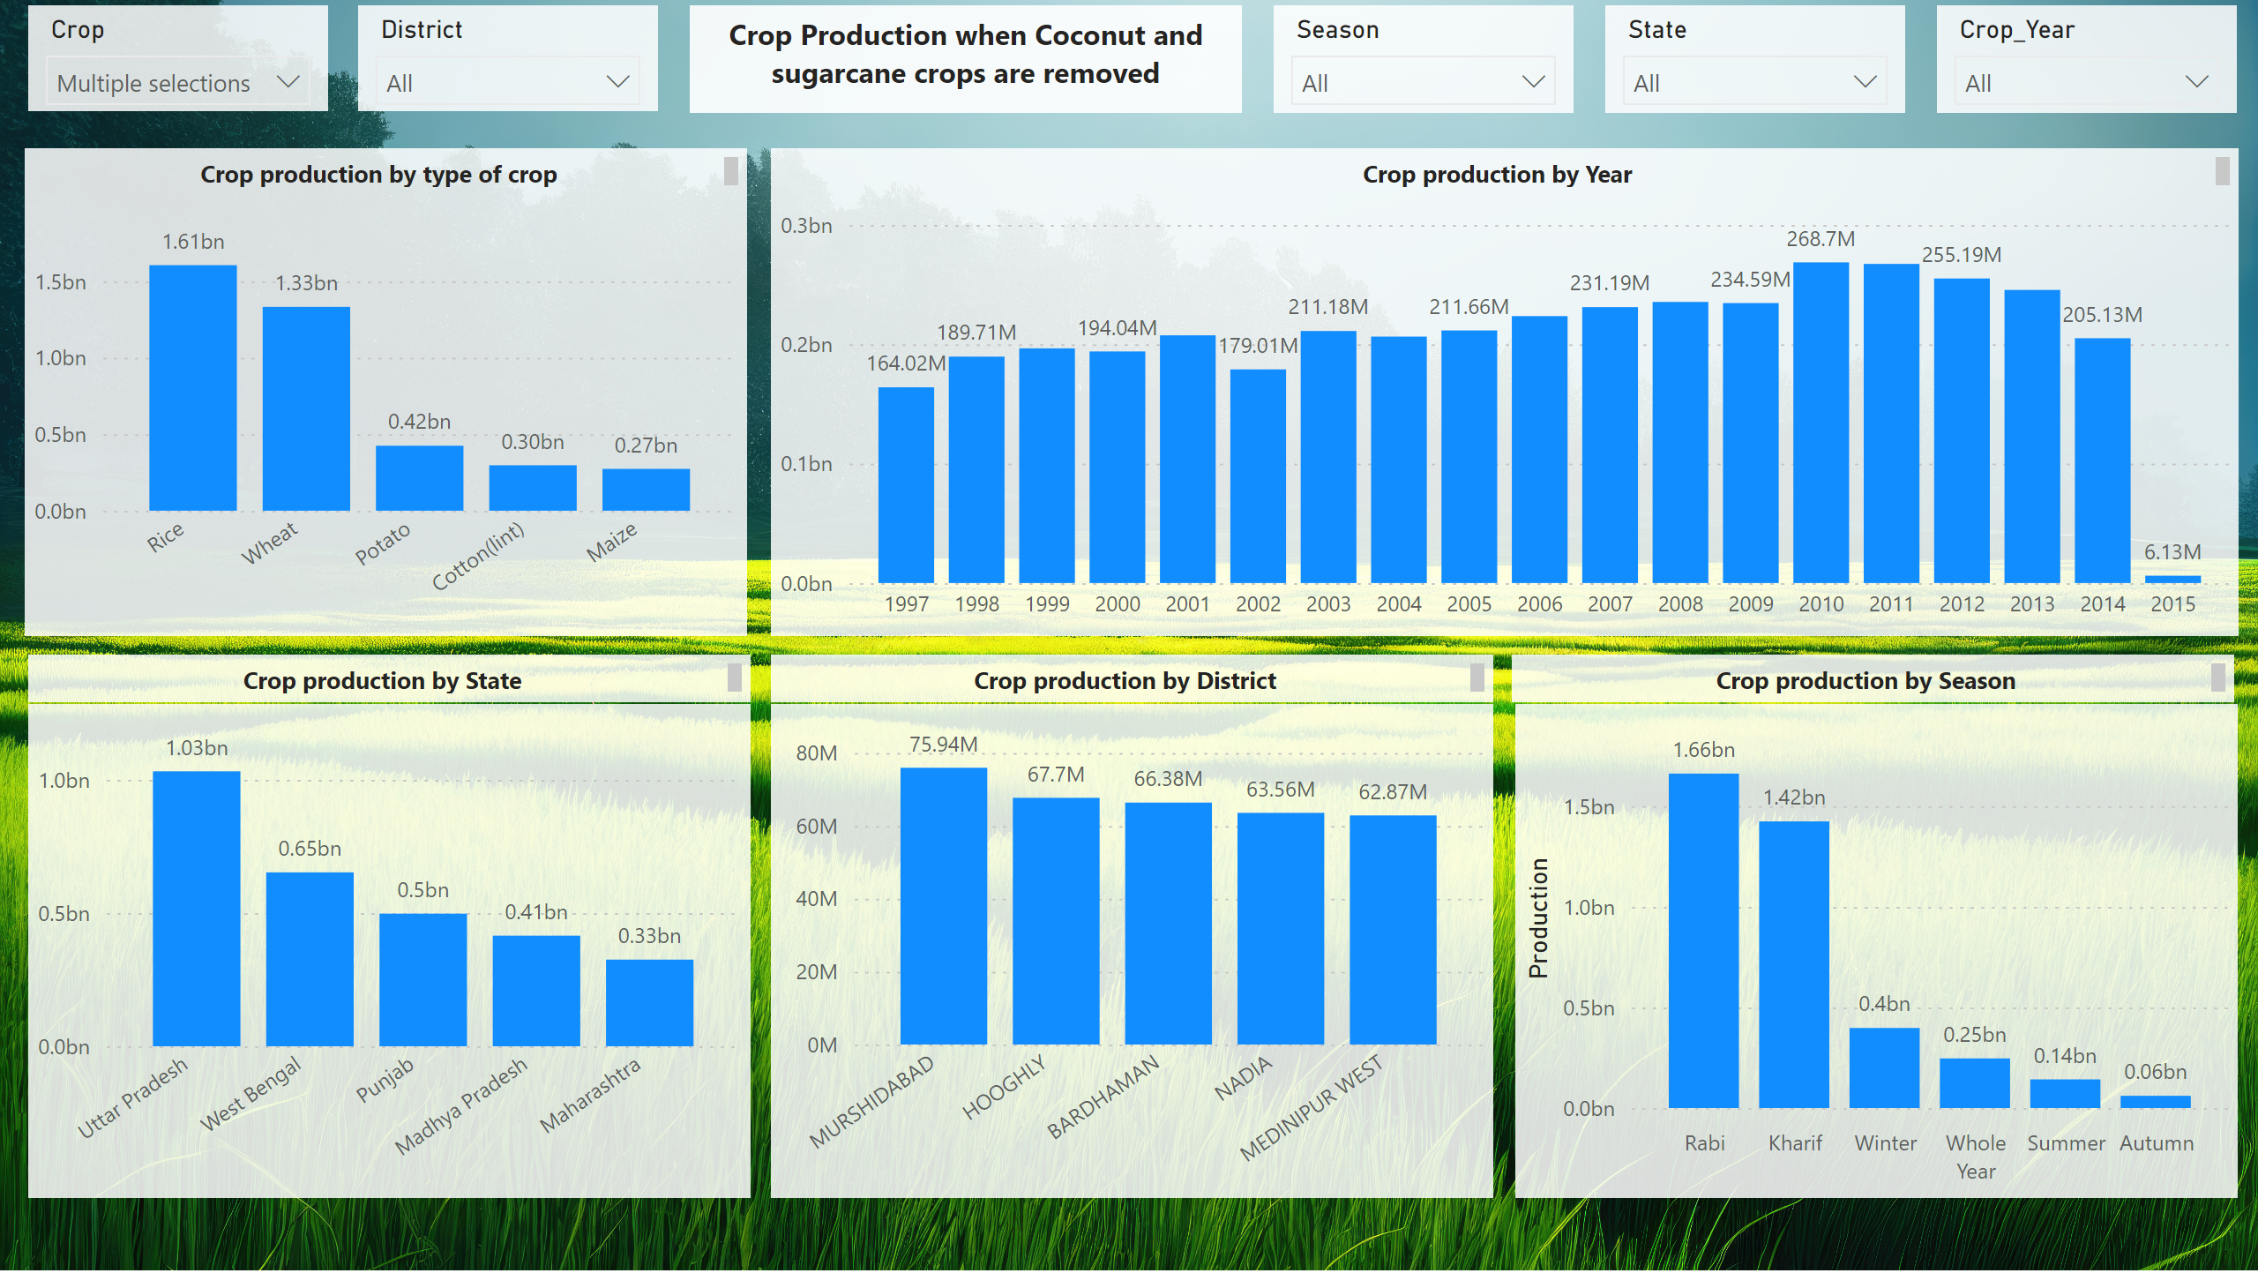
Production when top 2 crops are removed
Notes:
clusteredColumnChart
No alt text provided
slicer
No alt text provided
slicer
No alt text provided
slicer
No alt text provided
slicer
No alt text provided
slicer
No alt text provided
clusteredColumnChart
No alt text provided
clusteredColumnChart
No alt text provided
clusteredColumnChart
No alt text provided
clusteredColumnChart
No alt text provided
textbox
No alt text provided
textbox
No alt text provided
textbox
No alt text provided
textbox
No alt text provided
textbox
No alt text provided
textbox
No alt text provided

Slide 15
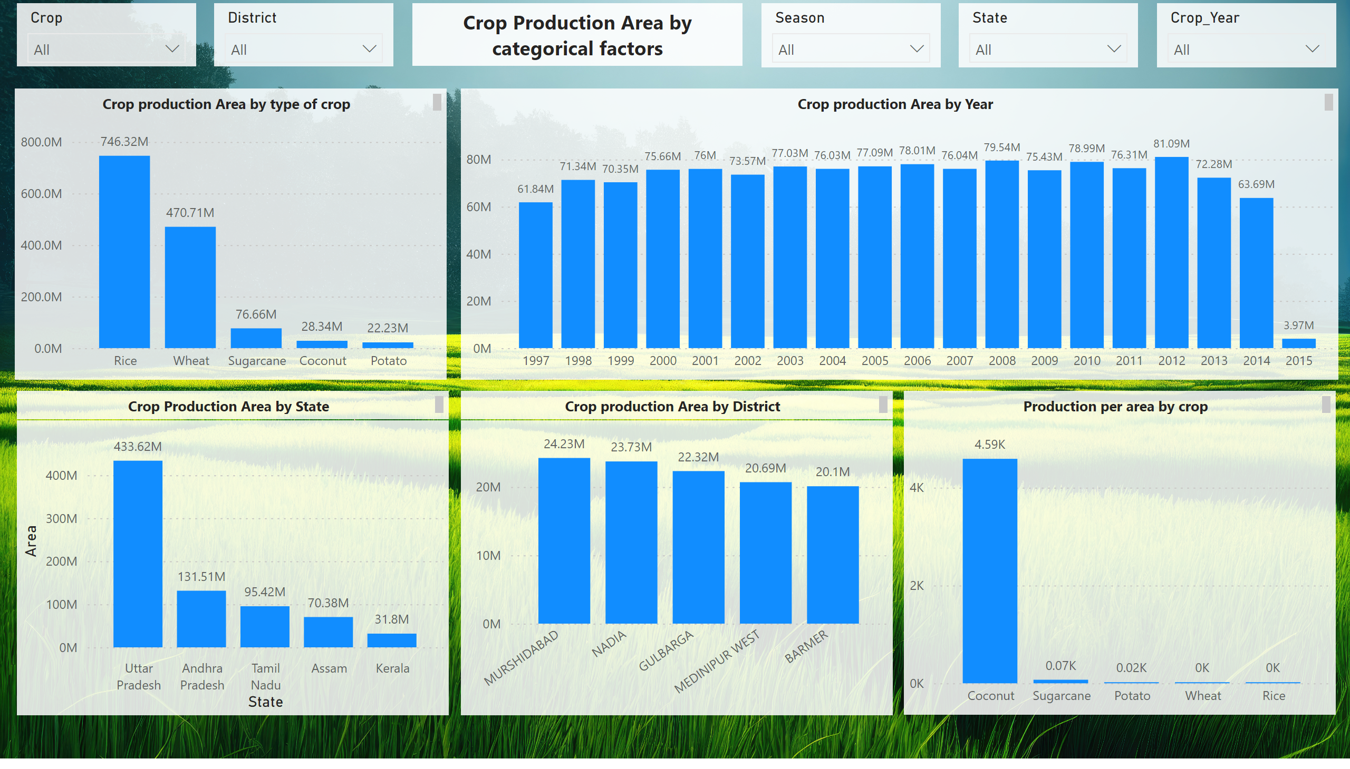
Production Area
Notes:
clusteredColumnChart
No alt text provided
slicer
No alt text provided
slicer
No alt text provided
slicer
No alt text provided
slicer
No alt text provided
slicer
No alt text provided
clusteredColumnChart
No alt text provided
clusteredColumnChart
No alt text provided
clusteredColumnChart
No alt text provided
textbox
No alt text provided
textbox
No alt text provided
textbox
No alt text provided
textbox
No alt text provided
textbox
No alt text provided
clusteredColumnChart
No alt text provided
textbox
No alt text provided

Slide 16
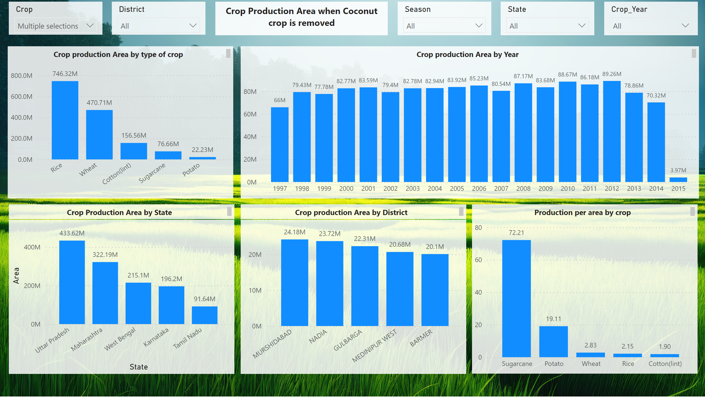
Production Area when top crop is removed
Notes:
clusteredColumnChart
No alt text provided
textbox
No alt text provided
textbox
No alt text provided
textbox
No alt text provided
textbox
No alt text provided
textbox
No alt text provided
textbox
No alt text provided
clusteredColumnChart
No alt text provided
clusteredColumnChart
No alt text provided
clusteredColumnChart
No alt text provided
slicer
No alt text provided
slicer
No alt text provided
slicer
No alt text provided
slicer
No alt text provided
slicer
No alt text provided
clusteredColumnChart
No alt text provided

Slide 17
Insights from exploratory data analysis
Coconut and sugarcane occupy the top two spots for the production of crop in India
Whole year crops are produced more than seasonal crops.
Kerala State produces the highest crops compared to any other state
When top two crops are removed then rice becomes the highest produced crop in India
When top two crops are removed then Uttar Pradesh becomes the state that produces the highest crops.
Rabi season crops are produced more than other seasonal crops when top two crops are removed
There is a variability in the crop production area throughout the years 1997 to 2015.
The production per area of coconut is the highest among all crops.
All the variables in the dataset influence the production to a significant degree

Slide 18
Feature engineering

Slide 19
Feature engineering
Feature engineering is the process of exploring the variables In a mathematical way so as to find with certainty about what variables influence the predictor variable i.e. production

Slide 20
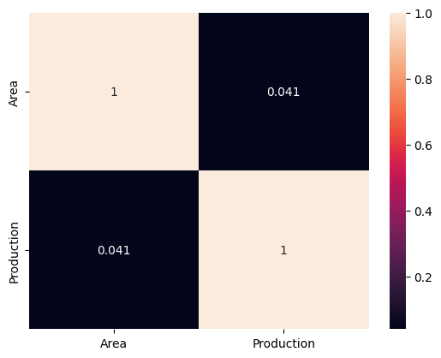
Feature engineering
Initially we calculate the correlation coeffient between the numeric variables i.e area and production. We find the correlation is very low (0.041). This process in coding is done during Exploratory data analysis stage but it is better explained here. The heatmap visual with the correlation coefficient is presented below.

Slide 21
Feature engineering
Since we have more categorical variables. We aggregate the data by those categories and calculate the correlation coefficient in light of those categories.
When we do that we run into a problem, the correlation coefficients of some of the categories show nan i.e null with division by zero warning. So we explore the data further to find out that some of the production values have zero in entry.
Some of the production values are zero because certainly not all crops are grown at all state and districts.
Considering the above data the best way to move forward is to drop the rows that have production value zero, because there is no tangible insight we could obtain from these rows. It may become possible to obtain insights from these rows but with the available data it become very difficult.
Thanks to the above factors 3523 rows that have production value has zero is dropped.
Now when we see the correlation coefficient, we see a high positive correlation between area and production for a lot of categories. So Agricultural Area influences Agricultural production

Slide 22
Feature engineering – anova analysis
Anova Analysis – Crop vs production
 | sum_sq | df | F | PR(>F)
C(Crop) | 8.55E+18 | 104 | 316.5614 | 0
Residual | 6.20E+19 | 238733 | NaN | NaN
Anova Analysis – Crop vs State_name
 | sum_sq | df | F | PR(>F)
C(State_Name) | 2.47E+18 | 32 | 270.9823 | 0
Residual | 6.81E+19 | 238805 | NaN | NaN
ANOVA for feature selection is a statistical technique for determining the association between numerous independent variables (features) and a single dependent variable (target. ANOVA aids in the process of identifying the most informative characteristics for use in developing prediction models or carrying out additional research by evaluating the importance of variations in means or variances across various feature levels or groups.
Anova Analysis – Crop vs District_name
 | sum_sq | df | F | PR(>F)
C(District_Name) | 3.76E+18 | 645 | 20.80315 | 0
Residual | 6.68E+19 | 238192 | NaN | NaN

Slide 23
Feature engineering – anova analysis
Anova Analysis – Crop vs Crop_Year
 | sum_sq | df | F | PR(>F)
C(Crop_Year) | 8.24E+15 | 18 | 1.549766 | 0.06367
Residual | 7.06E+19 | 238819 | NaN | NaN
Anova Analysis – Crop vs Season
 | sum_sq | df | F | PR(>F)
C(Season) | 2.55E+17 | 5 | 173.4015 | 8.01E-185
Residual | 7.03E+19 | 238832 | NaN | NaN
C(Category) - "C" stands for categorical variable, indicating the categorical column being analyzed in the ANOVA.
Residual - The residual, also known as the error term, represents the unexplained variation in the data after accounting for the effects of the factors being analyzed
Sum_sq - This column represents the sum of squared deviations from the mean. In ANOVA, there are typically two sources of variation: between groups (also known as "treatment" or "model" variation) and within groups (also known as "error" or "residual" variation).
df: Degrees of freedom represent the number of independent pieces of information available for estimating a parameter.
F : The F-statistic is a ratio of the variance between groups to the variance within groups. It is calculated by dividing the mean square for the factor by the mean square for the residual.
PR(>F): The p-value associated with the F-statistic indicates the probability of observing an F-value as extreme as, or more extreme than, the one calculated, assuming that the null hypothesis is true. In ANOVA, the null hypothesis typically states that there is no significant difference between group means (i.e., the factor being analyzed has no effect on the target variable).

Slide 24

Insights from anova analysis
Crop:
The variation in crop types significantly affects the target variable, as indicated by the large F-statistic of 316.56 and a p-value of 0, suggesting strong evidence against the null hypothesis. Different crops likely have distinct impacts on the outcome being analyzed.
State_Name:
Variation across different states significantly influences the target variable, with a high F-statistic of 270.98 and a p-value of 0. This suggests that the geographical location, possibly reflecting different climate conditions, soil types, or agricultural practices, has a notable impact on the outcome.
District_Name:
The district in which the data was collected also has a significant effect on the target variable, as indicated by the F-statistic of 20.80 and a p-value of 0. This suggests that local factors specific to each district, such as agricultural policies, infrastructure, or environmental conditions, play a role in determining the outcome.

Slide 25
Insights from anova analysis
Crop_Year:
While the variation in crop years shows some influence on the target variable, the evidence is less strong compared to other categorical variables, with a lower F-statistic of 1.55 and a p-value of 0.06367. This suggests that while there may be some differences in outcomes across different years, they are not as pronounced as other factors.
Season:
The variation in seasons significantly impacts the target variable, with a high F-statistic of 173.40 and an extremely low p-value (8.01E-185). This indicates that the choice of season, whether it be monsoon, winter, or summer, has a substantial effect on the outcome, likely due to differences in weather patterns and agricultural practices associated with each season.
These insights suggest that factors such as the type of crop, geographical location (state and district), and seasonality play crucial roles in determining the outcome variable in the dataset.
So for building a machine learning model we take all the categorical variables as features for our machine learning model.

Slide 26
Outlier treatment
The number of outliers for each of the numeric variables (Area and Production) are checked. It is found that there are 50,784 outliers.
Since the number of outliers is huge, we build our machine learning models with and without outliers and gather insights from it.
The next section completely focuses on this aspect.

Slide 27
Machine learning model

Slide 28
Machine learning model
Machine learning especially regression problems involves training algorithms to learn patterns from data and make predictions or infer relationships between variables, allowing for the estimation of continuous outcomes based on input features.

Slide 29
Machine learning
ML Algorithm results with outliers
Algorithm | MAE | RMSE | R2
Linear Regression | 2462638 | 17469573 | 0.192
Random forest | 130558.8 | 3735807 | 0.963
Xgboost | 156857 | 4521809 | 0.946
ML Algorithm results with outliers removed
We use mainly 3 regression algorithms in order to predict production. The comparison of results is done with and without outliers. For high performance GPU in google collab is used and some machine learning algorithms are from cuml library.
Algorithm | MAE | RMSE | R2
Linear Regression | 1178.01 | 1999.99 | 0.561
Random forest | 619.53 | 1312.65 | 0.811
Xgboost | 548.11 | 1175.88 | 0.848

Slide 30
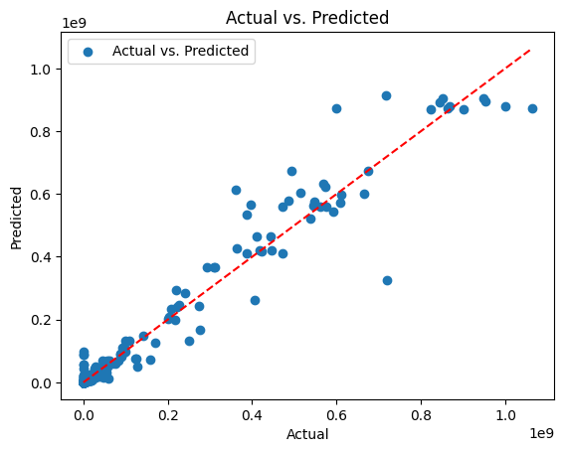
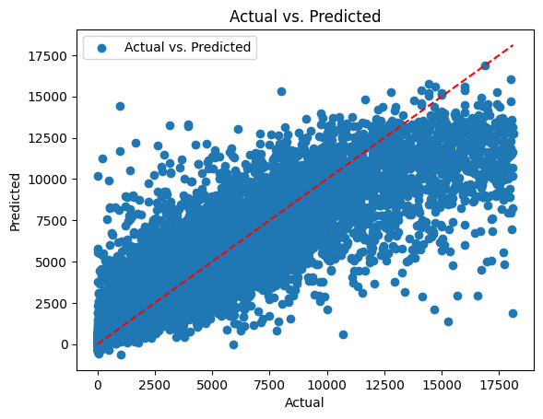
ACTUAL VS PREDICTED GRAPHS
Graph with outliers for random forest model
Graph without outliers for XG boost model

Slide 31
Insights from ML model prediction
The models perform poorly when outliers are present this is characterized by high MAE (Mean Absolute Error) and RMSE (Root Mean Square Error) but non linear models (Random forest and XG boost) were able to explain all the variables which is characterized by high R2 (Coefficient of Determination).
The models perform well when outliers are removed this is characterized by low MAE (Mean Absolute Error) and RMSE (Root Mean Square Error) the variables are better explained here for linear model slightly but the explainability of variables slightly reduces in non linear models this is conveyed by R2 (Coefficient of Determination) values.

Slide 32
conclusion
The random forest and XG boost model performs well irrespective of the outliers present in the data. This explains the tree based models versatility for model building.
The variables that explain the production of crops are explained with statistical backup.
Further work can include using PCA (principal component analysis) to reduce the feature size so that the model can become simple.
Different regression algorithms can be used with hyperparameter tuning for better performance.

Slide 33

Thank you
Sanjit Cyrus R
sanjitcyrus007@gmail.com​
https://www.linkedin.com/in/sanjit-cyrus/

